Slide 1
IS 120
Box Model, Display, and Position

Slide 2
Announcements
HW5 will be up after class
No class Wednesday
Project 1 next week
  DM me your project idea by Saturday

Slide 3
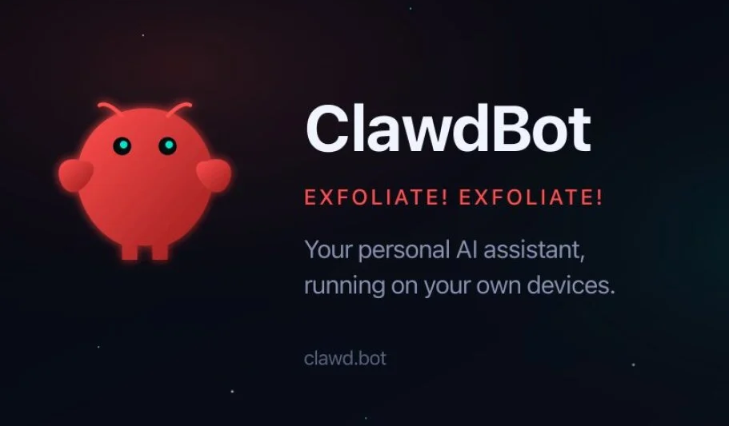

Slide 4
ClawdBot -> MoltBot -> OpenBot

Slide 5
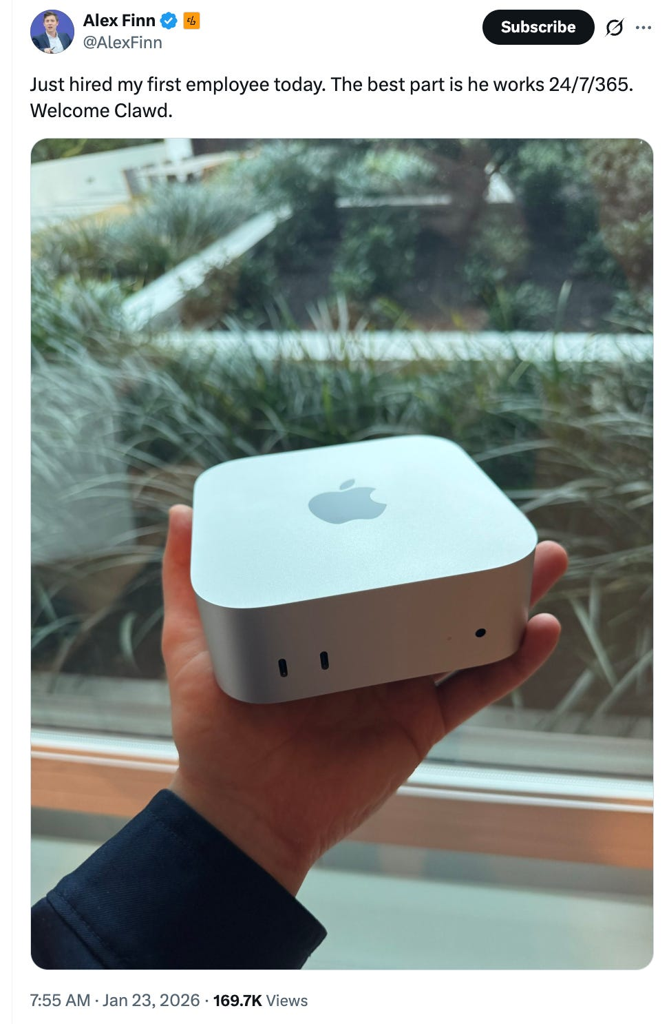
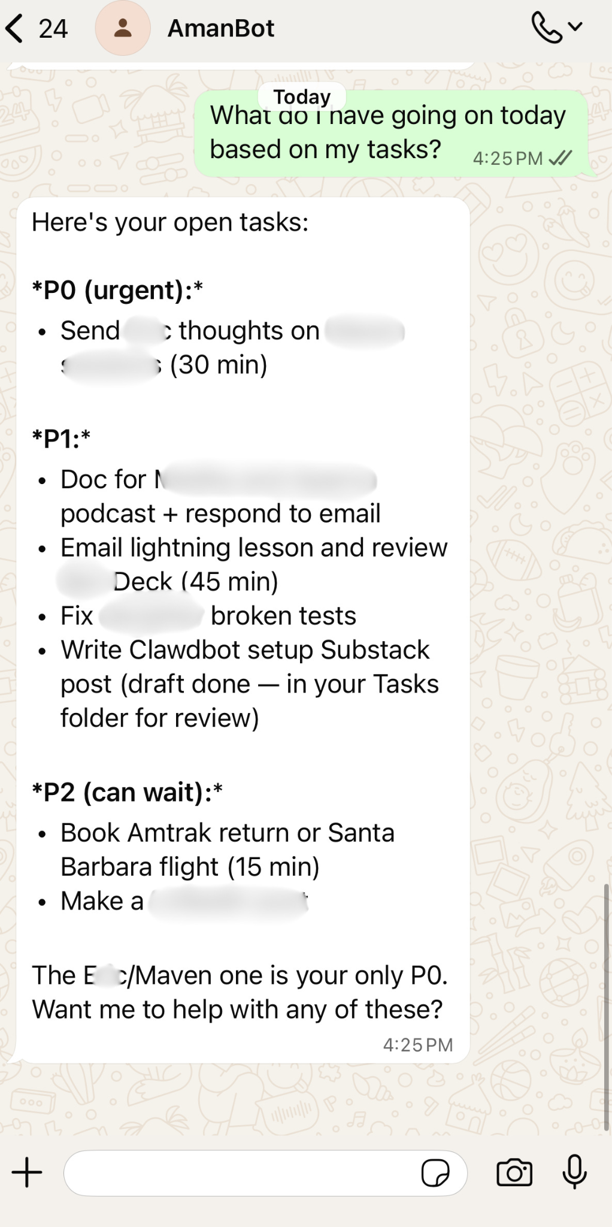
Full unrestricted computer access from any messaging app
100k+ GitHub stars in less than a month

Slide 6
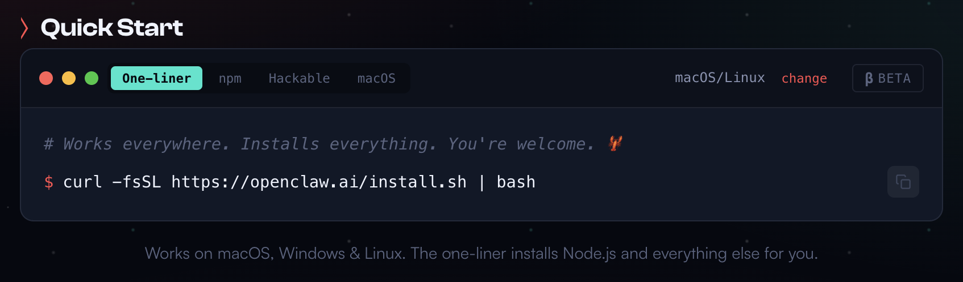

Slide 7
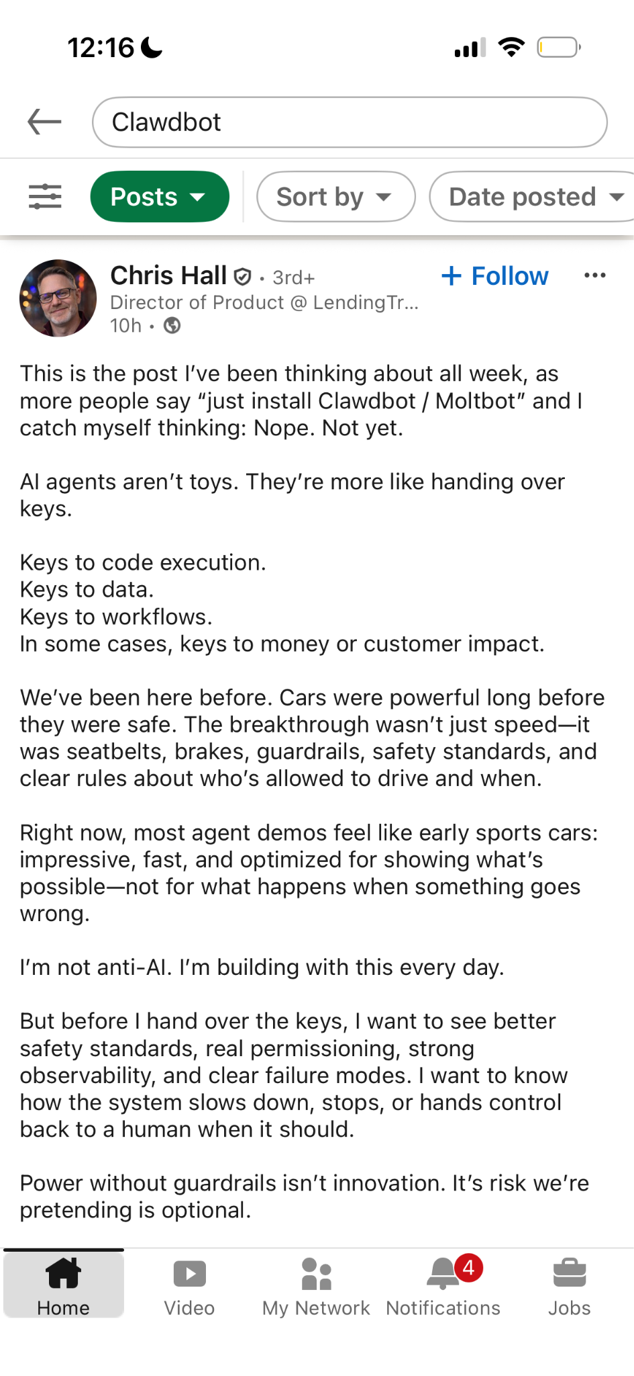

Slide 8
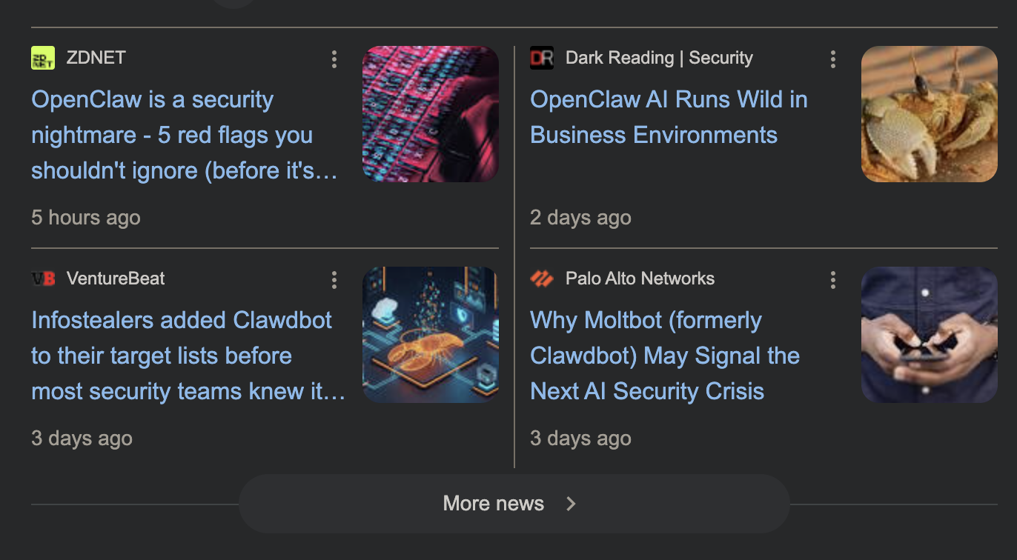
Prompt injection
Poisoned plugins
API key leaks
Exposed ports

Slide 9
Takeaways
Be careful with new technologies (especially scary AI ones)
Learn how technologies work before using them blindly
Even with powerful AI, we still need humans in the loop

Slide 10
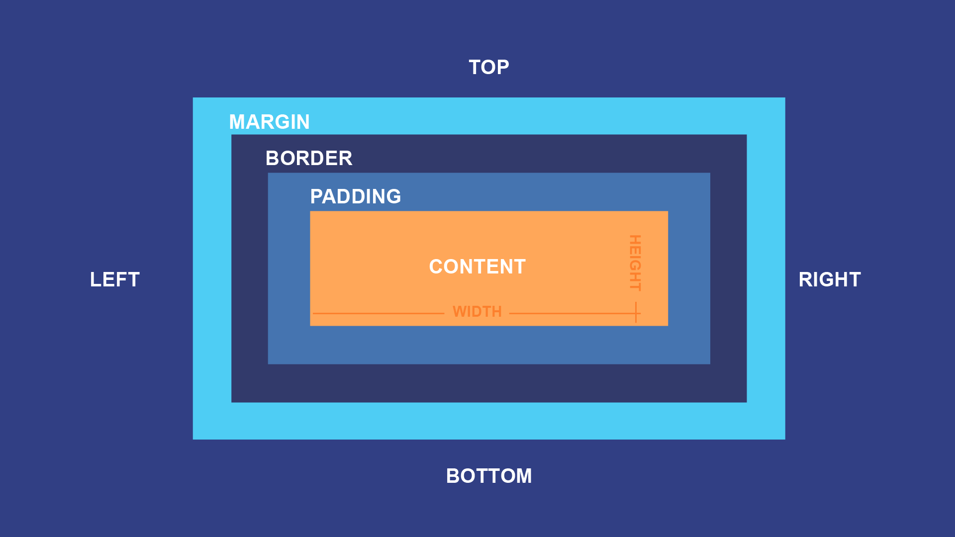
The Box Model

Slide 11
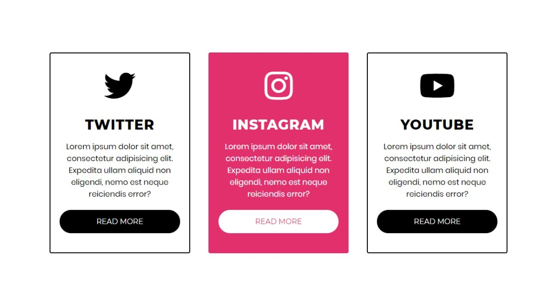
The Box Model

Slide 12
The Box Model
Content

Slide 13
The Box Model
Padding

Slide 14
The Box Model
Border

Slide 15
The Box Model
Margin

Slide 16
Box Model Example
https://smolcss.dev/

Slide 17
Box Sizing
Content-Box
Border-Box
HEIGHT
HEIGHT
WIDTH
WIDTH

Slide 18
Let’s go write some CSS

